Slide 1
Programmable logic families and embedded system design
KH Wong

Slide 2
Overview of this chapter
What is ASIC ?
    PAL (Programmable array logic)
FPGA (Field-programmable gate array)
CPLD (Complex programmable logic device)
SOC (system on chip)

Slide 3
Application Specific integrated circuit field (ASIC)
ASIC
  Full custom (ordered by user e.g. TSMC)
  Semi-custom (designed by user Apple I-phone. To be made by TSMC or Samsung)
  User programmable logic families
    PLA (Programmable array logic)
    PAL (Programmable logic array)
    GAL (gate array logic )
    CPLD (Complex programmable logic device)
    FPGA (Field-programmable gate array)
    SOC (system on chip)
      FPGA + Embedded processor (ARM)

Slide 4
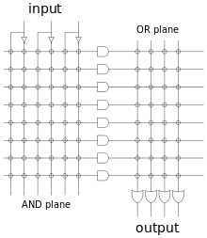
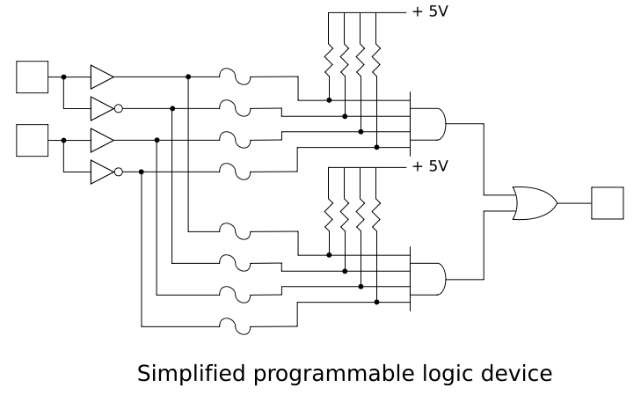
  User programmable logic families according to http://en.wikipedia.org/wiki/Programmable_logic_device#PLA
1) PLA (1970) Programmable Logic Array
  A programmable logic array (PLA) has a programmable AND gate array, which links to a programmable OR gate array, which can then be conditionally complemented to produce an output.
  E.g. TMS2000
2) PAL (1978) Programmable Array Logic
  PAL devices have arrays of transistor cells arranged in a "fixed-OR, programmable-AND" plane used to implement "sum-of-products" binary logic equations for each of the outputs in terms of the inputs and either synchronous or asynchronous feedback from the outputs.
  Example: PAL16R6

Slide 5
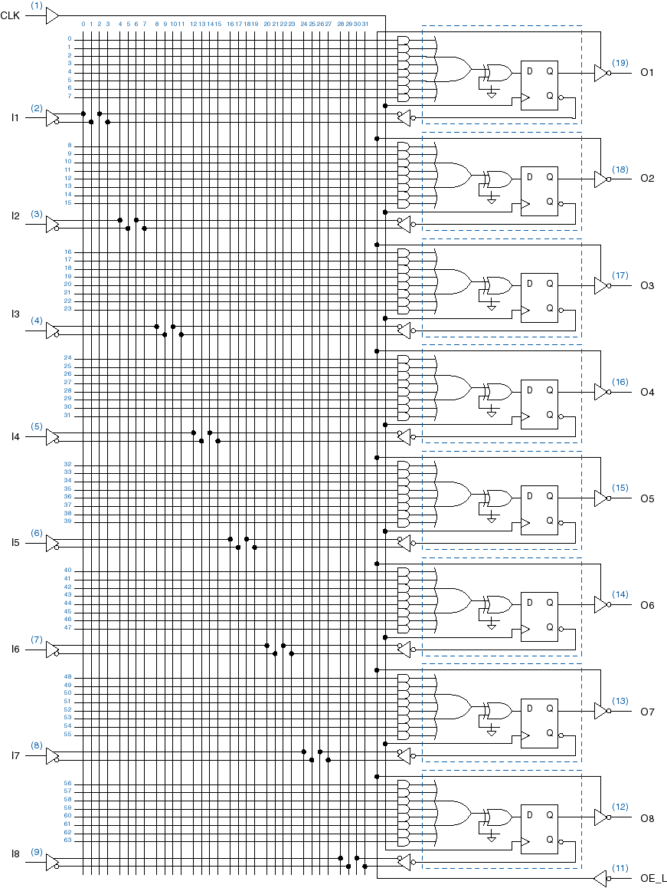
User Programmable logic families (continue) according to http://en.wikipedia.org/wiki/Programmable_logic_device#PLA
3) GALs (1985) Generic array logic
E.g. GAL16V8
Each output has an flip flop for making sequential logic
or / xor gates /Flip flops
Add plane

Slide 6
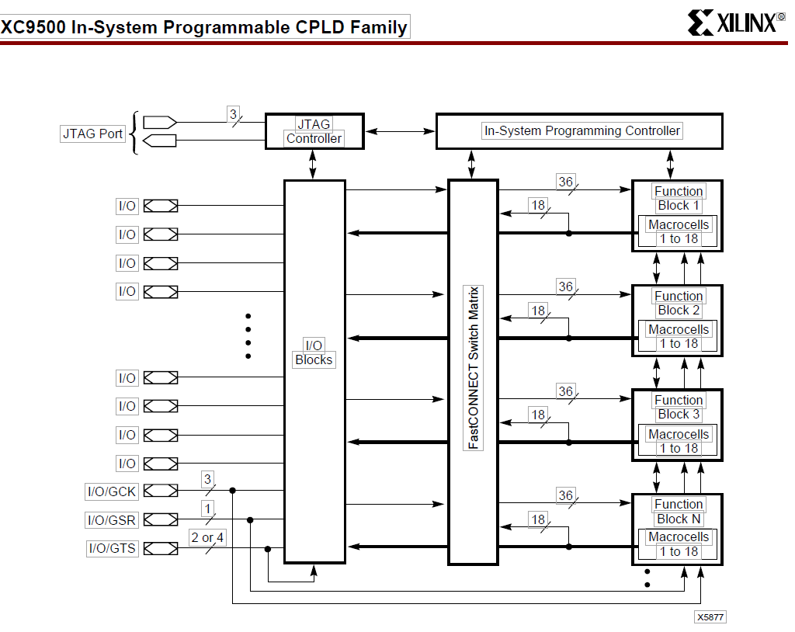
User Programmable logic families (continue)
4) CPLD (1999?) (Complex programmable logic device) e.g. xc9500 from xilinx
Non-volatile (program memory still there even after power off)
Next page

Slide 7
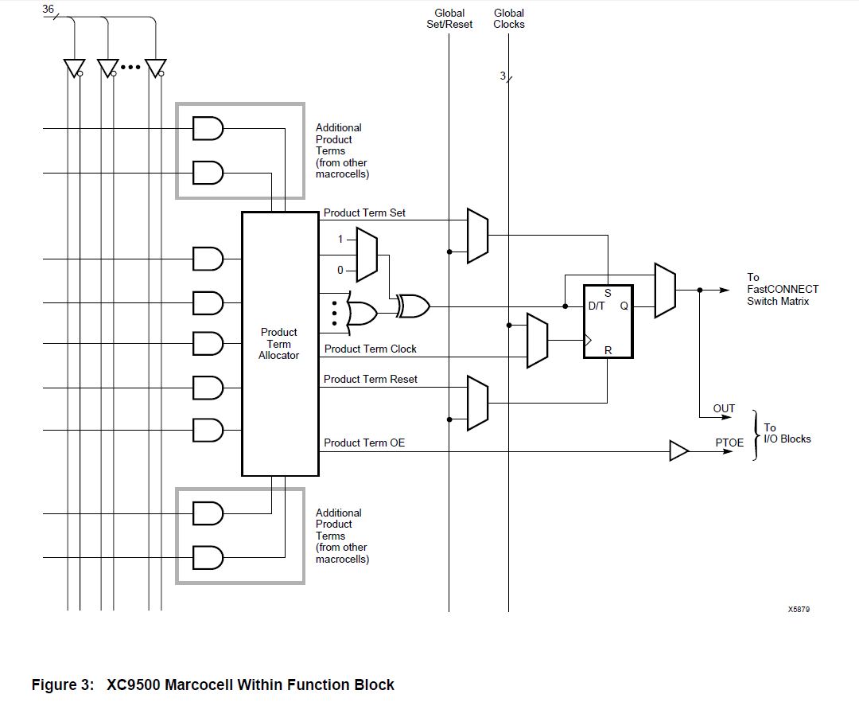
XC9500 Microcell within function block

Slide 8
User Programmable logic families (continue)
5) FPGA (1988?) (field programmable gate array)
E.g. XC4000 from Xilinx, volatile (also has non-volatile versions)

Slide 9
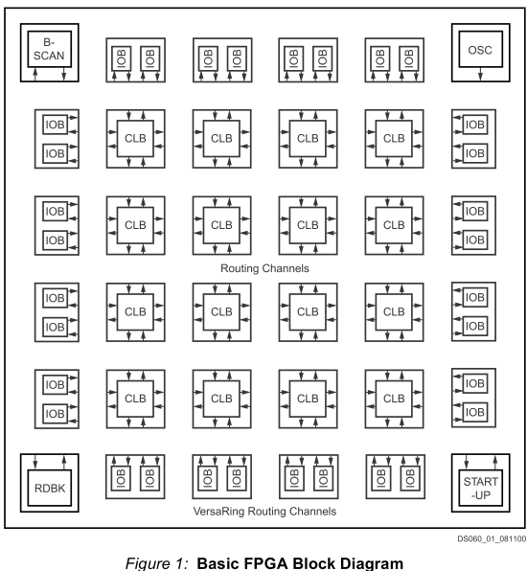
Re-programmable Hardware: FPGA Field Programmable Gate Array
So what is inside an FPGA
IOB=Input/Output block
CLB=Configurable Logic block (static ram based)
Change the CLBs to get the desired functions
From http://www.alldatasheet.co.kr/datasheet-pdf/pdf_kor/49173/XILINX/XCS10-3PC84C.html

Slide 10
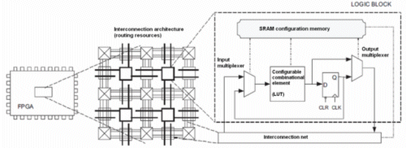
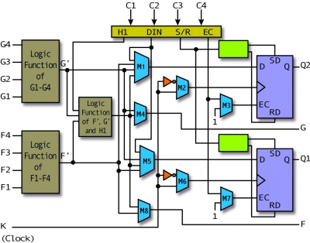
Inside a CLB (Configurable Logic block )
The CLB is a fixed design but you can change the logic function for generating output from input G1-G4 by reprogramming the bits in the logic function lookup table.
This will change the overall logic function of the CLB
Re-programming the logic table
CLB
FPGA CLB
(Configurable Logic block )
http://www.design-reuse.com/news_img/20100913_1.gif
http://pldworld.biz/html/technote/pldesignline/bobz-02.gif

Slide 11
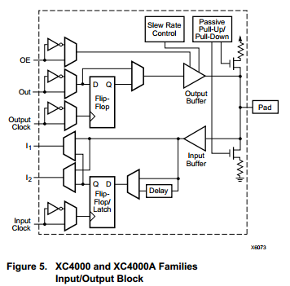
Inside an IOB (Input Output block )

Slide 12
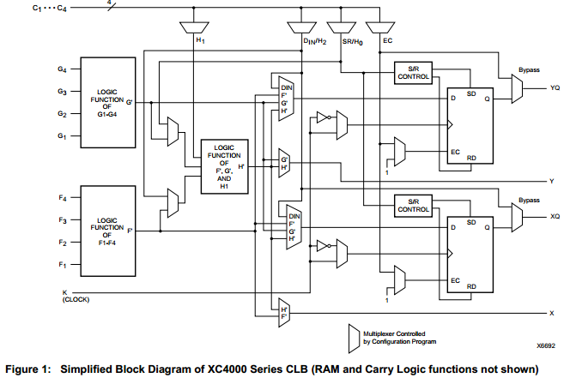
XC4000, each CLB (logic block)

Slide 13
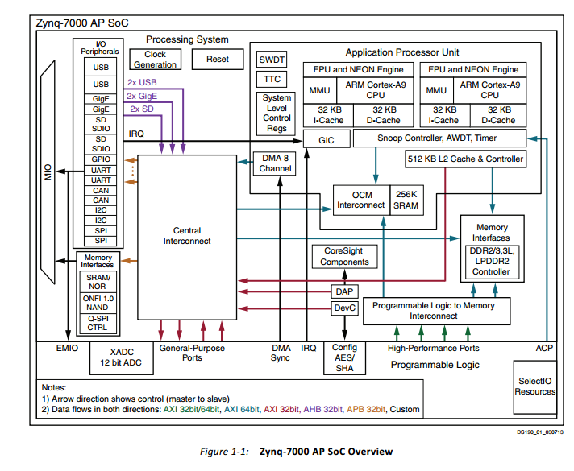
User Programmable logic families (continue)
6) SoC (2011?) (system on chip) Zynq-7000 AP SoC from xilinx
Has Programmable logic and embedded processor (ARM Cortex-A9)

Slide 14
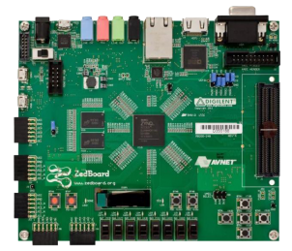
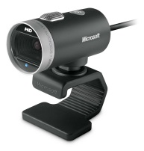
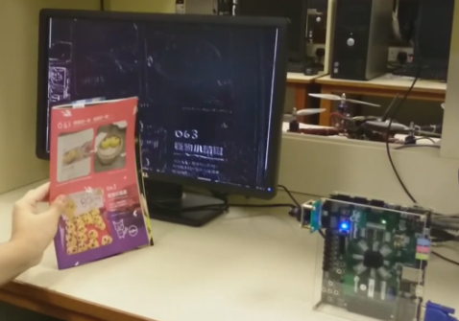
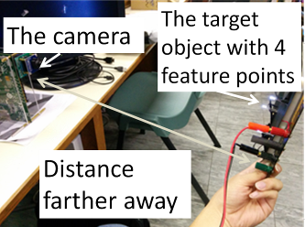
Development system based on Zynq-7000 in our lab
Zeboard(with Zynq-7000 SoC) + cos-camera
Support varies project
Examples: (Youtube links)
  Real time edge detection for computer vision
  SoC (FPGA +ARM) based computer vision
Sound recording and processing
Camera

Slide 15
Software tools
ISE (will become obsolete, recommended to use look-ahead versions
Vivado design tool (free versions are available)
  Vivado-system-design-zynq-training
  Please read the following link, you may get ideas for your own course free project.
  Xilinx and Zedboard projects http://hamsterworks.co.nz/mediawiki/index.php/FPGA_Projects

