Slide 1
VHDL 8
Practical examples
Part 1: 7-segment display ,
Part 2: A single board sound recorder
Part 3: Logic analyzer

Slide 2
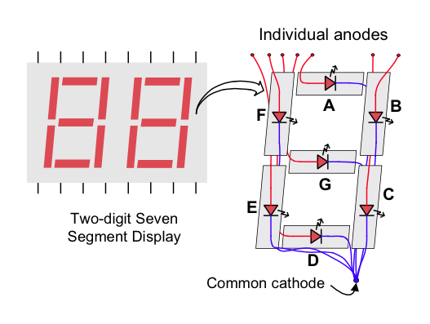
Part 1
7-segment LED display using VHDL

Slide 3
Lab5
In this exercise, you are required to display a hexadecimal number (XY) of two digits. Digit X on the left is to be controlled by input switch [3:0], and digit Y on the right is to be controlled by input switch [7:4].
To display the digits and save power, we have to switch between the two digitals using the digital selection signal (ssdcat) at a rate around 500kHz.
Task1: Implement the above requirement to display the hexadecimal number XY.
Task2: In addition to task1, add an input button to the system, after the button is pressed, the two digits will count from the number (XY) you entered to FF(hex) at a rate of one number per second. When the display reaches FF(hex), it will repeat counting from XY to FF again, and so on.
Digits X Y
https://www.beyond-circuits.com/wordpress/tutorial/tutorial4/

Slide 4
Define these in entity port declaration
entity sevenseg is
Port ( clk : in STD_LOGIC;
switch : in STD_LOGIC_VECTOR (7 downto 0);
ssd : out STD_LOGIC_VECTOR (6 downto 0);
ssdcat : out STD_LOGIC);
end sevenseg;
switch= user input switches
led: zedboard LED control
ssd: turn on/off individual LEDs in the active 7-segment
ssdcat: selects which 7-segment is active

Slide 5
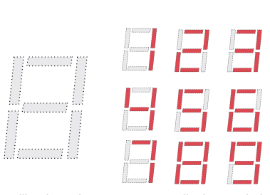
What is a 7-segment LED display?
ssd: turn on/off individual LEDs in the active 7-segment
ssd :turn on/off individual LEDs in the active 7-segment
Input Value | Segments Lit | ssd: Output Value
0 | A B C D E F | “1111110”
1 | B C | “0110000”
2 | A B D E G | “1101101”
3 | A B C D G | “1111001”
4 | B C F G | “0110011”
5 | A C D F G | “1011011”
6 | A C D E F G | “1011111”
7 | A B C | “1110000”
8 | A B C D E F G | “1111111”
9 | A B C F G | “1110011”
A | A B C E F G | “1110111”
b | C D E F G | “0011111”
C | A D E F | “1001110”
d | B C D E G | “0111101”
E | A D E F G | “1001111”
F | A E F G | “1000111”
https://www.beyond-circuits.com/wordpress/tutorial/tutorial4/

Slide 6
Multiple 7-segment LED display method
Time multiplexing:
  Because LED consumes high power
  Make one 7-segment active at one time will save power.
  Activate the 7-segment on the right then left at a rate of 1KHz and so on.
ssdcat : selects which 7-segment is active

Slide 7
VHDL for the 7-segment
Input: clk (100MHz clock), digit(input code)
process(clk)
begin
case digit is
when "0000"=>ssd<="1111110";
when "0001"=>ssd<="0110000";
when "0010"=>ssd<="1101101";
when "0011"=>ssd<="1111001";
when "0100"=>ssd<="0110011";
when "0101"=>ssd<="1011011";
when "0110"=>ssd<="1011111";
when "0111"=>ssd<="1110000";
when "1000"=>ssd<="1111111";
when "1001"=>ssd<="1111011";
when "1010"=>ssd<="1110111";
when "1011"=>ssd<="0011111";
when "1100"=>ssd<="1001110";
when "1101"=>ssd<="0111101";
when "1110"=>ssd<="1001111";
when "1111"=>ssd<="1000111";
end case;
ssd: turn on/off individual LEDs in the active 7-segment

Slide 8
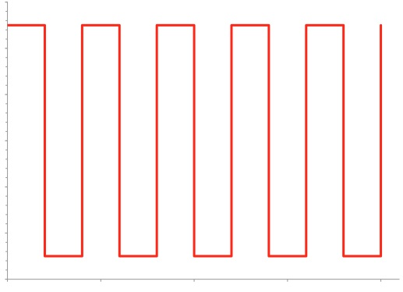
Create a 1KHz clock from a 100MHz clk
ms_pulse (1KHz)
0.5ms
If the clock frequency of clk is 100MHz
Create a 1 KHz (or 1ms-period) clock: ms_pulse
if rising_edge(clk) then
if (count=99999) then
ms_pulse <= not ms_pulse;
count<=0;
else
count <= count + 1;
end if;
end if;

Slide 9
Select input switch switches depending on ms_pulse
if ms_pulse='1' then
digit <= switch(7 downto 4)
else
digit <= switch(3 downto 0);
end if;
ssdcat <= ms_pulse;
ms_pulse (1KHz)
0.5ms

Slide 10
library IEEE; --(Vivado ok)
use IEEE.std_logic_1164.all;
use IEEE.std_logic_arith.all;
use IEEE.std_logic_unsigned.all;
entity syn_counter is
port (
CLK: in STD_LOGIC;
RESET,CE, load, DIR: in STD_LOGIC;
DIN: in std_logic_vector(3 downto 0);
COUNT: inout std_logic_vector(3 downto 0));
end syn_counter;
architecture Behavioral of syn_counter is
begin
process( reset, clk) begin
if(reset = '1') then COUNT <= "0000";
else
if(clk'event and clk = '1') then
if(load = '1') then COUNT <= din;
else
if(ce = '1') then
if( dir = '1') then
count <= count + 1;
else
count <= count -1;
end if;
end if;
end if;
end if;
end if;
end process;
end Behavioral;
Example of a up/down counter
(May be useful for the lab5 task2)

Slide 11
Hints for lab5-task2
Hints for Task2:
  To build the 1Hz, 8-bit counter with an output (call it sec_count), you need a slower input clock (1Hz). You can use the similar method for ms_pulse (1KHz) discussed earlier, and the input clock can be the ms_pulse signal.
  When the input button is pressed, toggle an enable signal (e.g. counter_en) to enable/disable the 1Hz counter . Also, initialize the counter value with the value of the switches.
  In each second, if the counter is enabled, increase the counter value by 1. If the counter value reaches 0xFF(hex), reset it to the value of the switches.
  Check the state of both sec_count and counter_en to determine the source of the digit to be displayed (either from the 1Hz counter or switches).

Slide 12
More hints for lab5 task2
  std_logic_vector cannot be incremented directly. Cast it to unsigned, signed or integer first.
  To convert signal type, you can refer to the figure in the appendix. For example, if you want to cast an integer sec_count to a 8-bit-unsigned std_logic_vector, you can type “std_logic_vector(to_unsigned (sec_count, 8))”.
  Avoid updating the same signal or I/O in different processes or else you will encounter multiple driver error (Remember processes within the same architecture run concurrently). However, it is safe to read them in different processes.
  If you receive error message “Poor placement for routing between an IO pin and BUFG” while running implementation stage, you may add “set_property CLOCK_DEDICATED_ROUTE FALSE [get_nets btn_IBUF]” in the constraint file to omit the issue.

Slide 13
Part 2
General concept of memory

Slide 14
Basic structure of a microprocessor system
CPU
Memory
Input/output and peripheral devices
Glue logic circuits

Slide 15
A computer system with a microprocessor
Clock
Oscillator
Micro-
Processor (CPU)
memory
Peripheral devices: serial, parallel interfaces; real-time-clock etc.
Peripheral devices: serial, parallel interfaces; real-time-clock etc.

Slide 16
Internal and external interfacing
External interfacing
Internal interfacing
memory
CPU
Peripheral IO interface devices: such as USB bus, parallel bus, RS232 etc.
Effectors: such as
Motors,
Heaters,
speakers
Keyboard
mouse
Light,
Temperature
sensors
Peripheral devices: USB ports, Graphic card, real-time-clock etc.

Slide 17
CPU, MCU are microprocessors
CPU: Central Processing unit
  Requires memory and input/output system to become a computer (e.g. Pentium).
MCU: micro-controller unit (or single chip computer)
  Contains memory, input output systems, can work independently (e.g. Arm7, 8051).
  Used in embedded systems such as mp3 players, mobile phones.

Slide 18
Memory systems
RAM/ROM

Slide 19
Different kinds of Memory (RAM)
Random access memory (RAM): data will disappear after power down.
  Static RAM (SRAM): each bit is a flip-flop
  Dynamic RAM (DRAM): each bit is a small capacitor, and is needed to be recharged regularly
Since we only discuss static (SRAM) here, so the terms SRAM and RAM will be used interchangeably.

Slide 20
Different kinds of Memory (ROM)
Read only memory (ROM)
  UV-EPROM
  EEPROM
  FLASH ROM

Slide 21
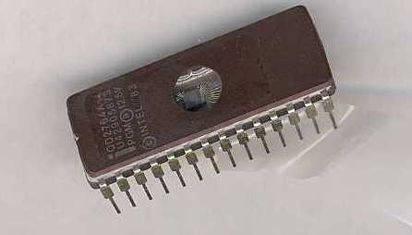
UV-EPROM

Slide 22
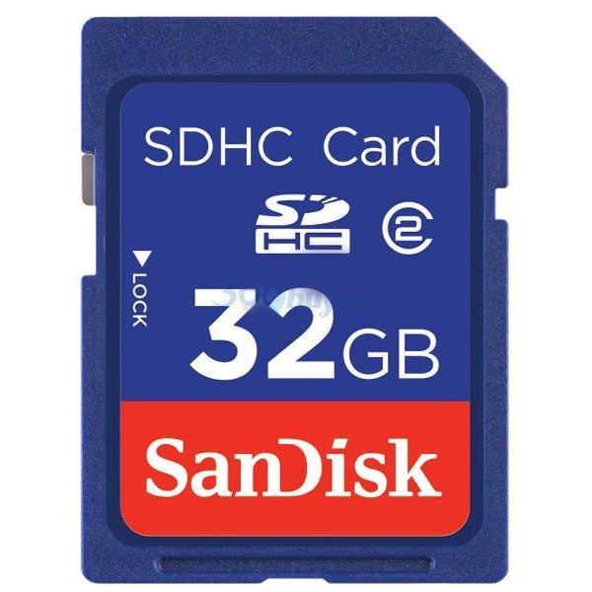
Flash memory
Or SD (secure digital card)
http://videoengineer.net/images/sdc32g2.jpg

Slide 23
Memory is like a tall building
Address cannot change; content (data) can change
Address content, e.g. A 32K-byte RAM
16-bit Address (H=Hex) | 8-bit content (data)
7FFF H | 35H
7FFF H | 23H
… | …
0ACD H | 24H
… | …
0001 H | 32H
0000 H | 2BH

Slide 24
How a computer works?
16-bit Address (H=Hex) | 8-bit content (data)
7FFF H | 35
7FFF H | 23
… | …
0ACD H | 24
… | …
0001 H | 32
0000 H | 2B (goto0ACD)
Program is in memory
CPU
program counter (16 bit) [PC]:
Keeps track of program location
After power up
PC=0000H

Slide 25
A simple program in memory
After power up, first instruction is in 0000H
An example
Address (H=Hex) | 8-bit machine code instructions (Hex) | 8-bit content (data)
0AC3 | 25 | Instruction j+3
0AC2 | 72 | Instruction j+2
0AC1 | 3B | Instruction j+1
0AC0 | 24 | Instruction j
… |  | …
0001 | xx | Instruction 2
0000 | 2B | Instruction 1
Register A

Slide 26
Program to find 2+3=?
Address (H=Hex) | 8-bit content (data)
0AC3 | Send content of 0AC2 to output port
0AC2 | (so this is the answer for 2+3 =5)
0AC1 | Add 2 to Reg .A and save in next location
0AC0 | Save 3 into Reg. A
… | …
0001 | …
0000 | Goto address 0AC0 H
Register A

Slide 27
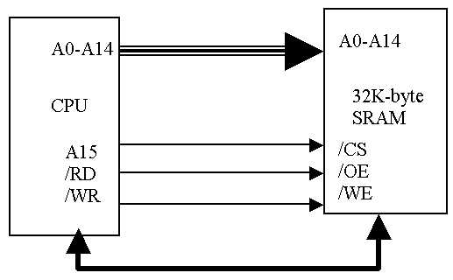
CPU and Static memory (SRAM) interface
Exercise: show the address space of the CPU and memory
Data bus is bi-directional DIN,DOUT are using the same bus (D0-D7)

Slide 28
Exercises 8.1
A) What is the address space for an address bus of 24 bits?
B) How many address bits are required for a space of 4G bytes?
C) Why do most computers use 8-bit as the bit length of an address?

Slide 29
Memory read/write
Timing diagrams
http://www.alliancememory.com/pdf/AS6C62256.pdf

Slide 30
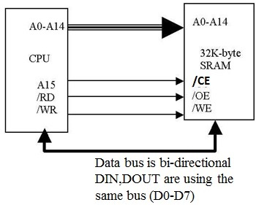
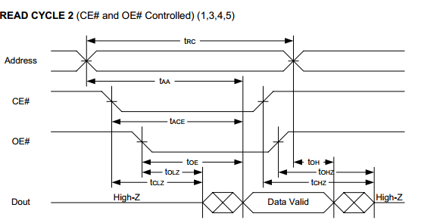
A read cycle t_{RC}, from SRAM memory to CPU
Procedure:
  T0: setup address,
  T1: pull down /CE,
  T2: pull down /OE,
  T3: Dout data start to come out of memory, must be valid at T4
  T4: Pull up /CE
  T5: pull up /OE
For reading
(minimum 55ns)
All signals are coming out of CPU except Dout is from memory to CPU
Note:
  T2 can happen at the same time as T1 but not before.
  T5 can happen at the same time as T4 but not before.
T0 T1 T2 T3 T4 T5

Slide 31
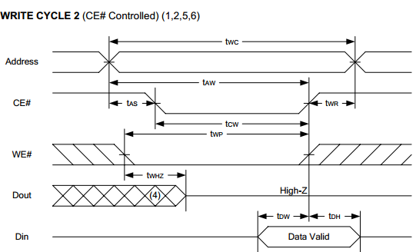
A write cycle t_{WC,}, from CPU to SRAM memory
Procedure:
  T0: setup address,
  T1: pull down /WE,
  T2: pull down /CE
  T3: Din data start to come out of CPU, must be valid at T4
  T4: Pull up /CE and /OE at the same time
For writing
Data bus is bi-directional
DIN,DOUT are using the
same bus (D0-D7)
Data bus is bi-directional
DIN,DOUT are using the
same bus (D0-D7)
(minimum 55ns)
All signals coming out of CPU
Dout is at high impedance all the time
T0 T1 T2 T3 T4

Slide 32
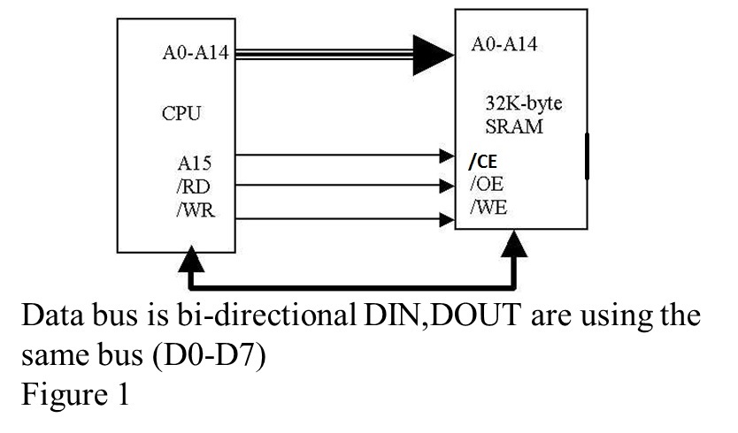
Exercises 8.2
(A): Redesign the CPU/SRAM interfaces circuit in figure 1 so that the address-range is 8000-FFFFH instead of 0000-7FFFH.

Slide 33
Exercises 8.2B
(B): Redesign the CPU/SRAM interface circuit in figure 1 to add another SRAM to make the system occupies the whole 0000-FFFFH address-range.

Slide 34

How to read timing diagrams ? part1
Valid bus
High-to-low, low-to-high uncertain regions

Slide 35

How to read timing diagrams? part2
Float (High-Z) to uncertain then valid
T0 T1 T2

Slide 36
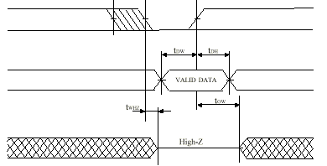
Exercise8.3 , explain this timing diagram

Slide 37
Address decoding

Slide 38
Exercises 8.4
A CPU supports 128K-byte (has address pin A0-A16 = 17 pins, so 2¹⁷=128K) of memory area.
Exercise2.4: How many 32K-SRAMs do we need?

Slide 39
Exercise 8.5a
A CPU supports 128K-byte (has address pin A0-A16 = 17 pins, so 2^17=128K) of memory area. We need an address decoder to enable the (/CS) input of each SRAM. Complete the following diagram.
Address decoder /CS0
/CS1
/CS2
/CS3
A0,A1
Address lines:
A15, A16
A0-A14
/WR
/RD
Data bus
D0-D7
32K
SRAM1
/CS
A0-A14
/OE
/RD
D0-D7
32K
SRAM2
/CS
A0-A14
/OE
/RD
D0-D7
32K
SRAM3
/CS
A0-A14
/OE
/RD
D0-D7
32K
SRAM4
/CS
A0-A14
/OE
/RD
D0-D7

Slide 40
Exercise 8.5b :Memory decode for a system with 128K-byte size using four 32-byte RAM chips , fill in the blanks.
A16,A15,……..A0 (17 bits) | Address range ( 5 hex.) | Range size
0 0xxx xxxx xxxx xxxx | 0 0000 - 0 7FFF H | 32K
0 1xxx xxxx xxxx xxxx | 0 8000 - 0 FFFFH | 32K
_ _xxx xxxx xxxx xxxx | 1 0000 - 1 7FFFH | __ K
1 1xxx xxxx xxxx xxxx | _ ____ - _ ____H | 32K

Slide 41
Exercise 8.5c: fill in the address decoder truth table
A16 ,A15 | /CS0 | /CS1 | /CS2 | /CS3
0 0
0 1
1 0
1 1

Slide 42
Address decode rules
Decode the upper address lines using a decoder.
Connect lower address lines directly to memory devices.

Slide 43
Exercise 8.6
Fill in the modes (in, out, inout or buffer) of the input/output signal.
 | SRAM (memory) | CPU
address lines (A0-A16)
data lines (D0-D7)
/CS,/OE and /WE lines

Slide 44
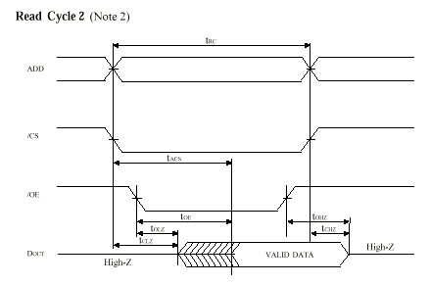
Exercise 8.7
tRC
Referring to the figure, what would happen if /RD of the CPU (connected to /OE) goes up before the data valid region occurs?
ADD
/CE
Or (/CS)
/OE
DOUT

Slide 45
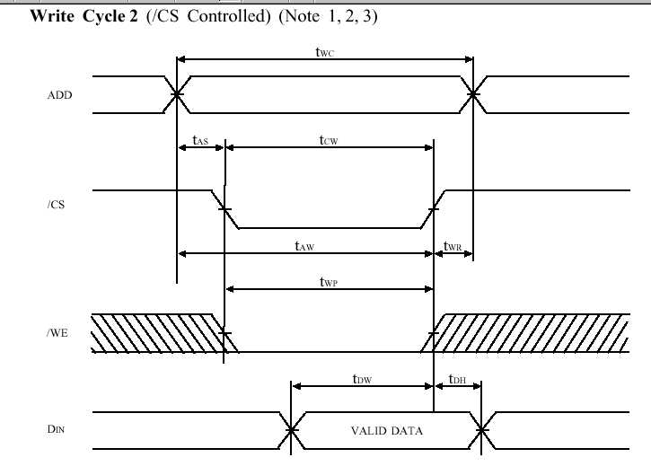
Exercise 8.8 :
Referring to the Figure,
if t_{AS}=0ns, t_{wc}=100ns,t_{CW}=80ns, give comments on the limits of t_{AW}, t_{WP} and t_{DW..}
tWC
ADD
/CE
Or (/CS)
/WE
DIN
tCW
tAW
tWP
tDW

Slide 46
Part 3
The Logic Analyzer

Slide 47

The Logic Analyzer
Overall diagram
DA_in[7..0]
Serial port
Reset
Rec
Play
Xilinx based hardware
ARM7 board
DA_out[7..0]
RAM
Display waveform

Slide 48
Memory (32K) interface
entity logic_rec is
Port ( clk40k_in: in std_logic;
reset: in std_logic;
rec, play: in std_logic; --user inputs
-- mem RAM bus
bar_ram_we27: out std_logic;
bar_ram_cs20: out std_logic;
bar_ram_oe22: out std_logic;
-- 32k-byte
ram_address_buf: buffer std_logic_vector(14 downto 0);
ram_data_inout: inout std_logic_vector(7 downto 0);
da_data_out: buffer std_logic_vector(7 downto 0);
da_data_in: in std_logic_vector(7 downto 0));
end logic_rec;

Slide 49
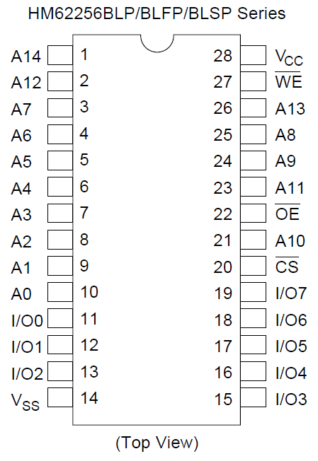
Static memory (SRAM 32Kbytes) data pins
Diagrams are obtained from data sheet of HM62256B

Slide 50
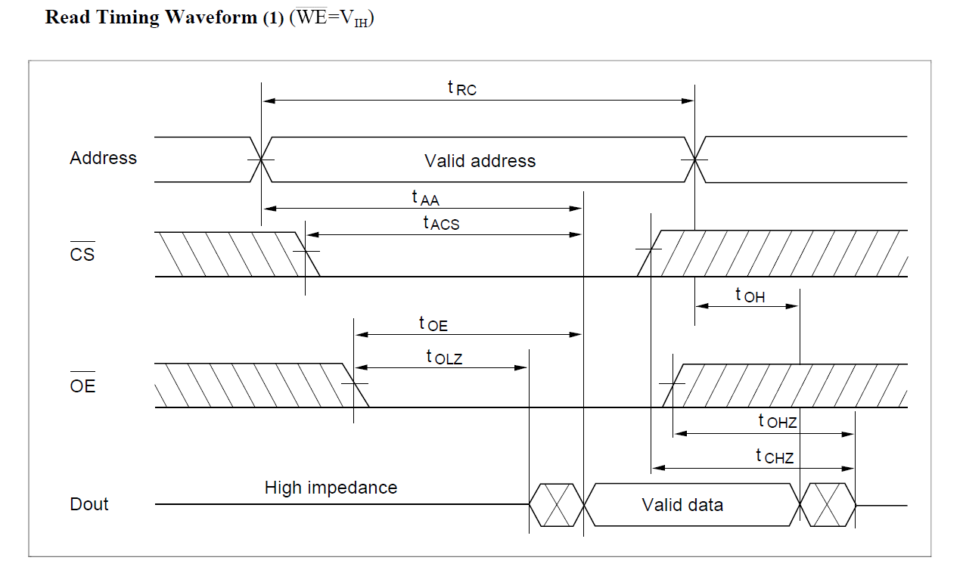
HM62256B Memory read timing diagrams

Slide 51
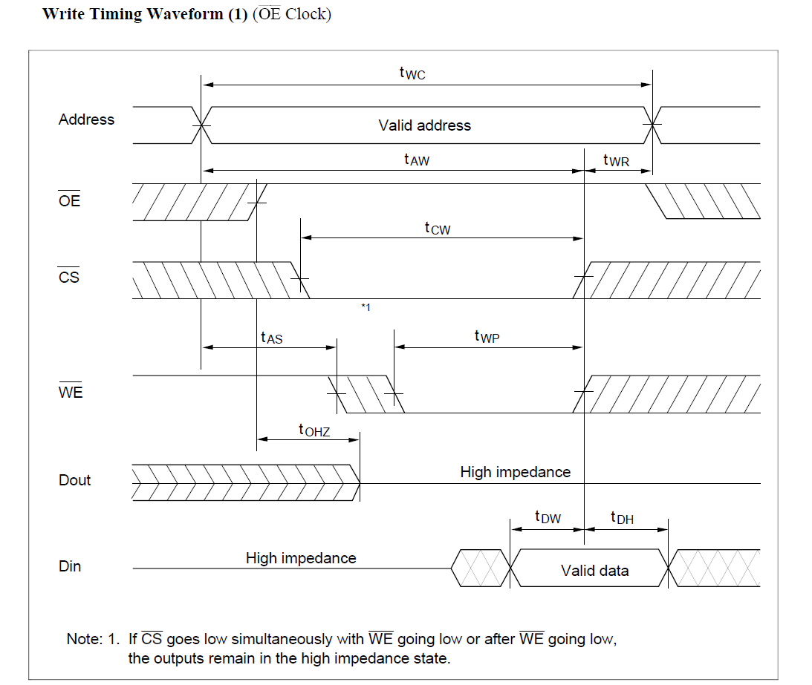
HM62256B Write mode timing diagram

Slide 52
Flow diagram
reset=‘0’
s_init
rec=‘0’
play=‘0’
s_rec_address_change
s_play_address_change
s_rec_read_from_da_to_reg1
s_play_cs_oe_down
s_rec_we_cs_down
s_play_read_in_reg1
s_rec_writeto_da_ram
s_play_writeto_da
ram_address_buf =not all’1’
ram_address_buf =not all’1’
ram_address_buf =all’1’

Slide 53
Architecture
architecture Behavioral of logic_rec is
-- SYMBOLIC ENCODED state machine: Sreg0
type Sreg0_type is (s_init, s_rec_address_change, s_rec_we_cs_down, s_rec_read_from_da_to_reg1, s_rec_writeto_da_ram, s_play_address_change, s_play_cs_down, s_play_oe_down, s_play_read_in_reg1, s_play_writeto_da);
signal state_ram1: Sreg0_type;
signal data_reg1: std_logic_vector (7 downto 0);
begin
process (CLK40k_in,reset)
begin
if reset = '0' then --loop count
state_ram1 <= s_init;
elsif CLK40k_in'event and CLK40k_in = '1' then

Slide 54
State s_init
case state_ram1 is
when s_init => --state: initial state
bar_ram_we27<='1';
bar_ram_cs20<='1';
bar_ram_oe22<='1';
ram_address_buf<="000000000000000";
ram_data_inout<= "ZZZZZZZZ";
if rec='0' then
state_ram1<=s_rec_address_change;
elsif (play='0') then
state_ram1<=s_play_address_change;
else
state_ram1<=s_init;
end if;

Slide 55
State s_rec_address_change
-- signal record cycle starts here
when s_rec_address_change => -- state: rec01
bar_ram_we27<='1'; --make sure all ram pins up
bar_ram_cs20<='1';
bar_ram_oe22<='1';
if (ram_address_buf="111111111111111") then
state_ram1<=s_init;
else
ram_address_buf<=ram_address_buf+1;
state_ram1<=s_rec_read_from_da_to_reg1;
end if;

Slide 56
States: s_rec_read_from_da_to_reg1 and s_rec_we_cs_down
when s_rec_read_from_da_to_reg1 => --state: rec02
bar_ram_cs20<='0';
bar_ram_we27<='1';
bar_ram_oe22<='1';
data_reg1<=da_data_in;
state_ram1<=s_rec_we_ce_down;
when s_rec_we_cs_down => -- state rec03
bar_ram_cs20<='0';
bar_ram_we27<='0';
bar_ram_oe22<='1';
state_ram1<=s_rec_writeto_da_ram;

Slide 57
State s_rec_writeto_da_ram
when s_rec_writeto_da_ram=> -- state: rec04
bar_ram_we27<='0';
bar_ram_cs20<='0';
bar_ram_oe22<='1';
ram_data_inout<=data_reg1; --write to ram
--goback to record another sample
state_ram1<=s_rec_address_change;
--the ram control pins will be up at s_rec_address_change

Slide 58
State: s_play_address_change
-- signal playback state machine cycle starts here
when s_play_address_change => -- state: play01
-- fill in the code for this state
To be done by students in the lab.

Slide 59
Conclusion
Showed how to make a single board logic analyzer by VHDL
Can be modified for sound recorder, digital camera, mp3 player etc.

Slide 60
Bonus Part
Using a FIFO (first in first out) memory

Slide 61
FIFO RAM
Very similar to the previously introduced SRAM.
It has an internal counter to ensure the data are read and written in FIFO manner.
No need to specify address.

Slide 62
Interface of FIFO RAM
SRCK, SWCK : clock for read and write, data out refreshed after each rising edge
RSTW, RSTR : signal to reset the read/write counter to the 0th address.
WE : write enable signal to take new data after each rising edge of the write clock

Slide 63
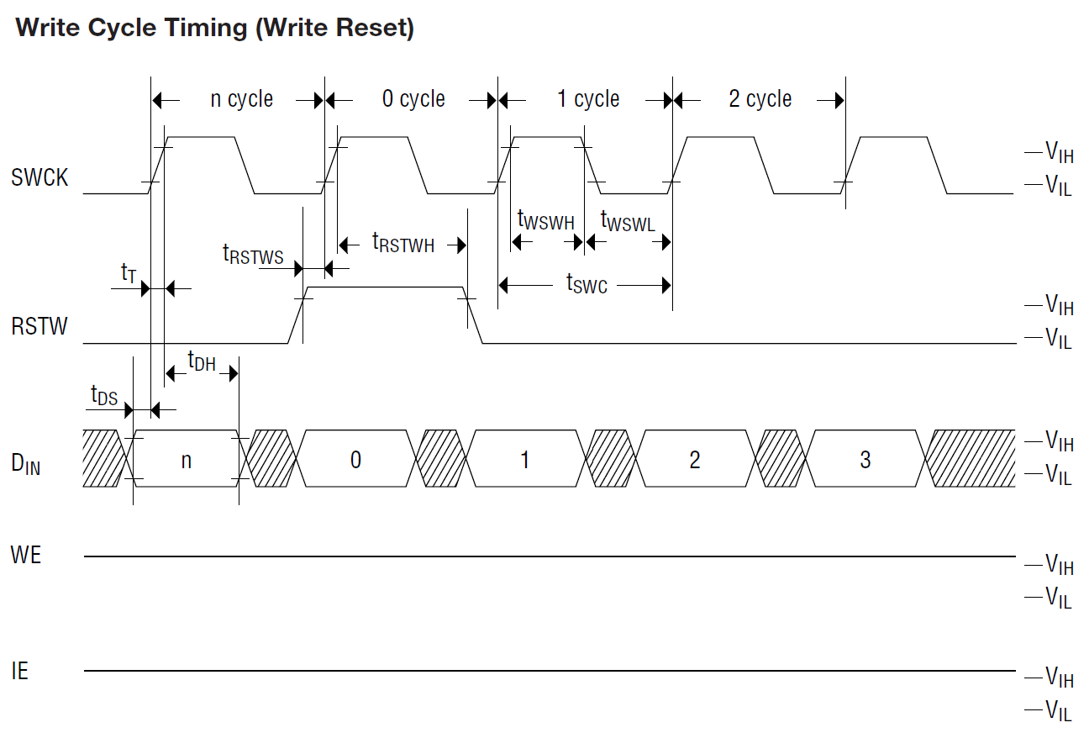
Timing Diagram for FIFO RAM

Slide 64
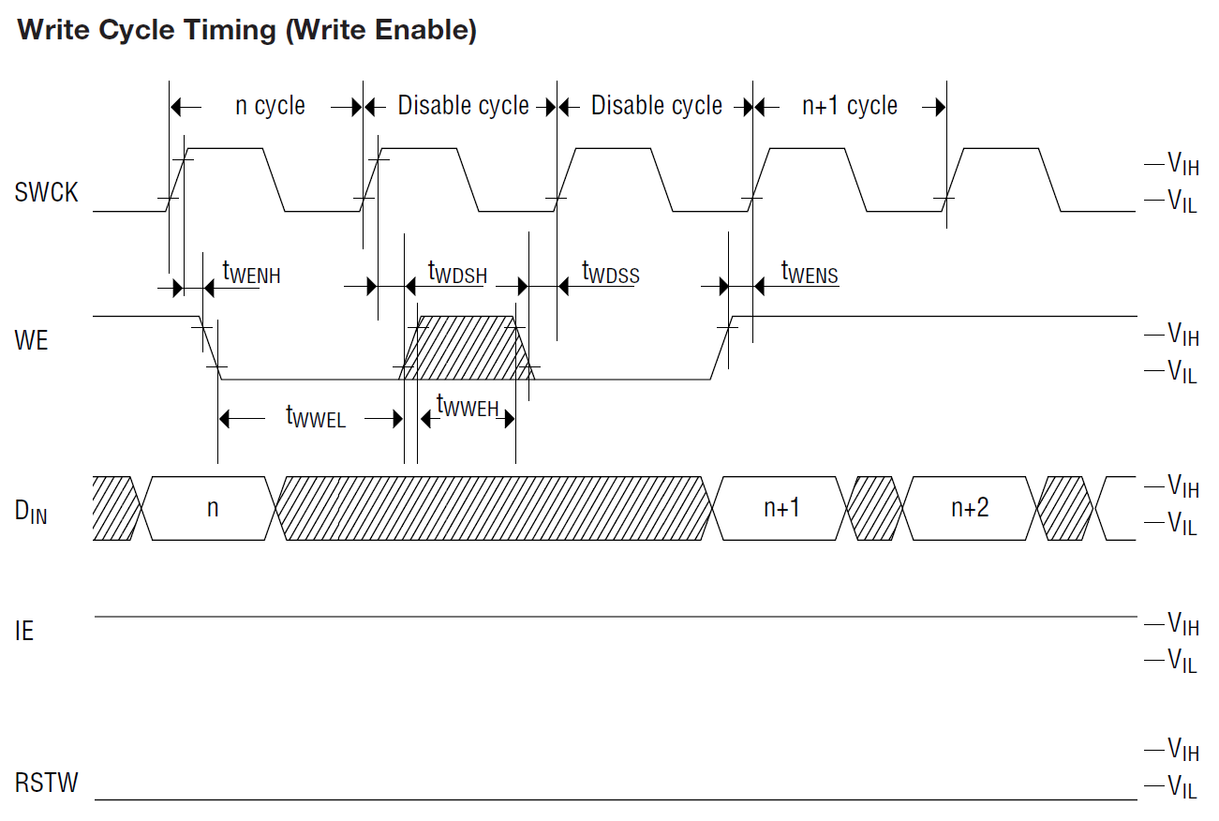
Timing Diagram for FIFO RAM

Slide 65
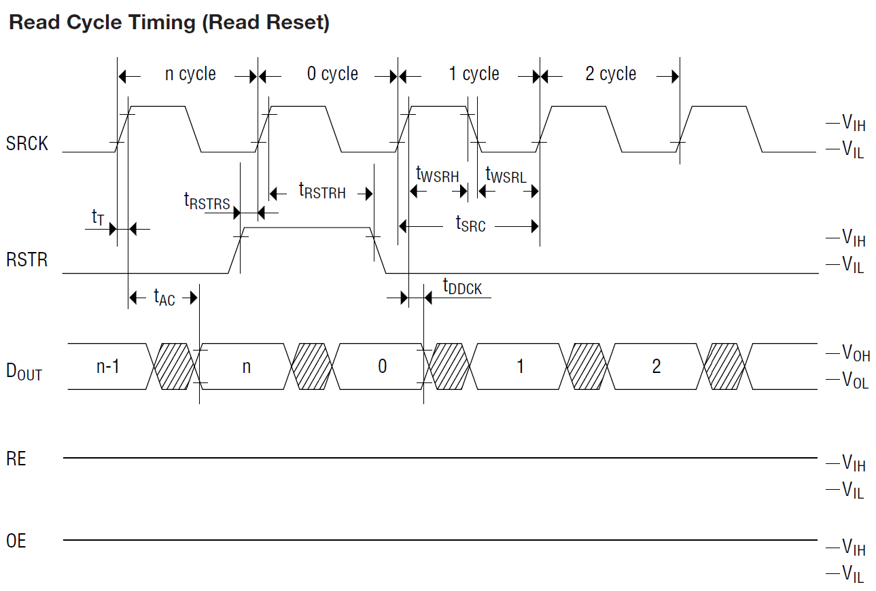
Timing Diagram for FIFO RAM

Slide 66
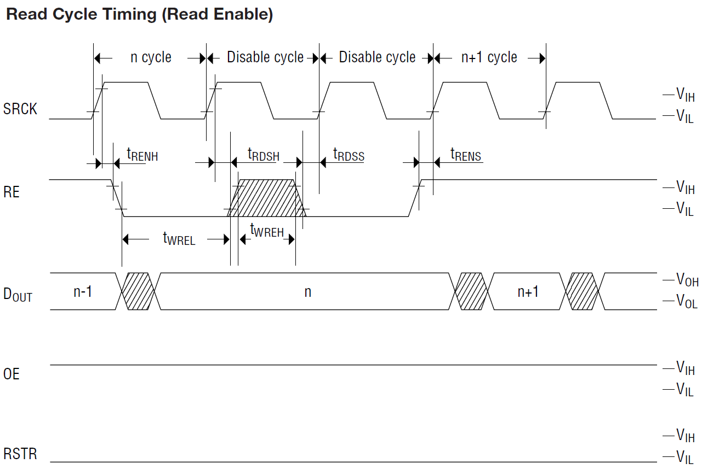
Timing Diagram for FIFO RAM

Slide 67
Flow Diagram
Work to do in each state will be introduced in the following slides

Slide 68
FSM states
State 0 : Initial state
  Transition : If record button is pressed, go to State 1
  If play button is pressed, go to State 3
  If no button is pressed, remain at State 0
  Things to do : 1. unable RAM writes
  2. dis-reset RAM write counter
  3. dis-reset RAM read counter
  4. stop RAM write clock
  5. stop RAM read clock
  6. stop counter clock
  7. reset counter

Slide 69
FSM States
State 1 : Write counter resetting state
  Transition : Go to State 3 directly
  Things to do : 1. reset RAM write counter
State 3 : Read counter resetting state
  Transition : Go to State 4 directly
  Things to do : 1. reset RAM read counter

Slide 70
FSM States
State 2 : Record state
  Transition : If stop signal is high, go to state 0
  else remain at state 2
  Things to do : 1. enable RAM writes
  2. start RAM write clock
  3. stop RAM read clock
  4. start counter clock
  5. dis-reset counter
  6. dis-reset RAM write counter

Slide 71
FSM States
State 4 : Play state
  Transition : If stop signal is high, go to state 0
  else remain at state 4
  Things to do : 1. disable RAM writes
  2. stop RAM write clock
  3. start RAM read clock
  4. start counter clock
  5. dis-reset counter
  6. dis-reset RAM read counter

Slide 72
Sound Recorder utilizing
FIFO RAM
To be done in the lab.
A full skeleton code is given but need to fill in missing part in the FSM.

Slide 73
Conclusion
Showed how to make a single board sound recorder by VHDL
Can be modified for digital camera, mp3 player etc.

